Slide 1
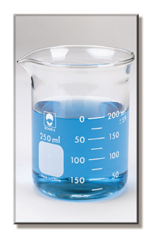
Lab equipment Project

Slide 2
Homework
Construct a flip book to identify at least 10 laboratory equipment with their functions and illustration.

Slide 3
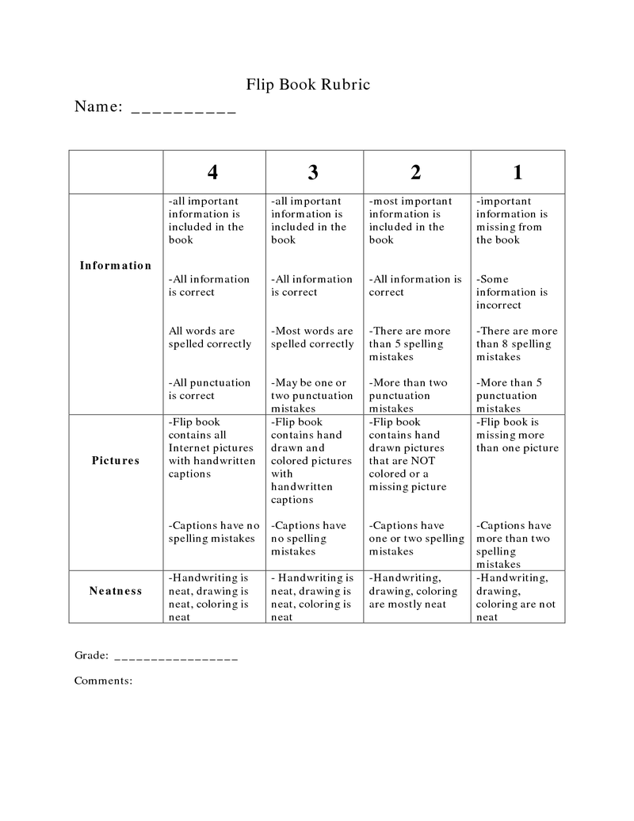
Rubric

